Slide 1

Implementation of MQTT-SN in OMNeT++ Tayfun Gumus
Advisor: Prof. Alessandro Redondi

Slide 2
MQTT-SN overview
Application protocol used in the field of Internet of Things (IoT)
It derives from MQTT, specifically designed for Wireless Sensor Networks (WSNs) within resource-limited scenarios, such as computing power, bandwidth and energy
Adopts publish/subscribe pattern, enabling publishers to distribute messages to subscribers on specified topics, all managed by the central broker
Operates over UDP, vulnerable to packet loss without error control
To mitigate the issue, different Quality of Service (QoS) levels are provided, ensuring flexible and prioritized message delivery

Slide 3
Objectives
The goal of the project is to delve into MQTT-SN by:
Correctly implementing it within a simulation environment
Conducting QoS analysis to evaluate the protocol behavior under certain simulation conditions

Slide 4
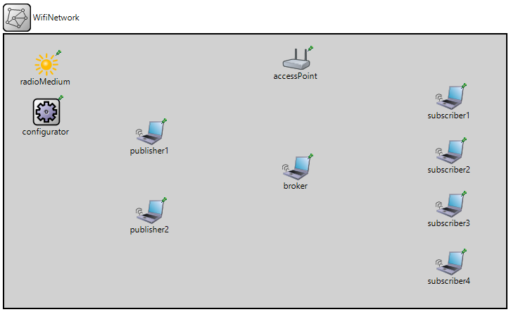
Implementation with OMNeT++
Modular, component-based C++ simulation environment with INET library integration for realistic network and communication modeling
The implementation adheres to standard MQTT-SN specifications, ensuring protocol functionality
An 802.11 wireless network simulation with typical MQTT-SN scenario: publishers send data to subscribers through a broker

Slide 5
Quality of Service (QoS) evaluation
Following implementation, QoS assessment is performed
Key performance metrics, end-to-end delay and hit rate, are applied to publication packets, enabling a quantitative evaluation of different QoS levels
Introduction of packet errors through a controlled Bit Error Rate (BER) to simulate realistic network conditions
Comparative analysis of the results obtained for different QoS levels, highlighting the impact of packet errors on the selected metrics

Slide 6
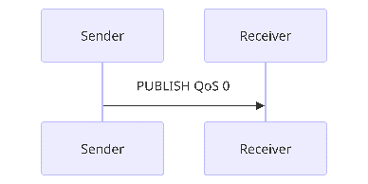
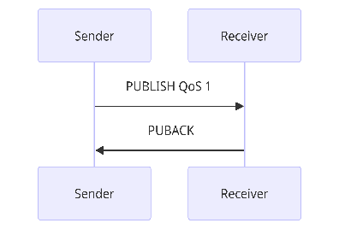
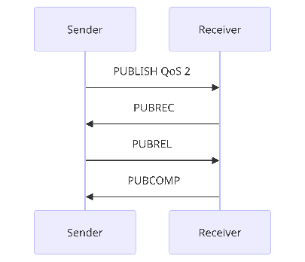
QoS levels overview
QoS 0 (At most once): provides best-effort delivery with no acknowledgment required, whereas QoS -1 is similar but operates without even establishing a connection
QoS 1 (At least once): ensures message delivery with acknowledgments; sender retransmits if necessary. Duplicates are managed by the receiver
QoS 2 (Exactly once): guarantees unique message delivery through a two-step acknowledgment process between sender and receiver, eliminating duplicates

Slide 7
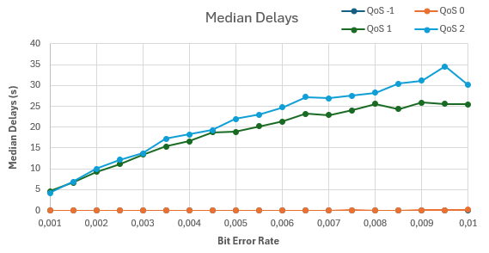
QoS comparison: end-to-end delay
Lower QoS levels, QoS -1 and QoS 0, outperform higher levels with publications delivered in milliseconds, thanks to their no-acknowledgment approach
Conversely, QoS 1 and QoS 2 show longer delays due to handshake waiting and retransmissions in case of errors
QoS 1 exhibits less delay than QoS 2 attributed to fewer packet exchanges

Slide 8
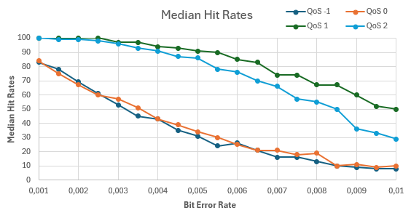
QoS comparison: hit rate
QoS 1 and QoS 2 achieve significantly higher hit rates than the other levels, a result of their acknowledgment and retransmission mechanisms
QoS -1 and QoS 0 demonstrate similar performances, with QoS 0 slightly better due to the establishment of a connection setup
QoS 1 exceeds QoS 2 in hit rates, due to QoS 2's extra exchanges. QoS 1 allows duplicates; QoS 2 ensures uniqueness

Slide 9
Conclusions
Quality of Service choice directly depends on the application's needs, balancing between responsiveness and reliability
Lower QoS levels are suitable for applications that require responsiveness as a priority, but in contrast, packet losses will be high in error-prone environments
QoS 1 and QoS 2 are appropriate to manage applications that have reliability as key requirement, despite the reactivity loss
Moreover, QoS 2 is crucial for sensitive applications in which delivery only once is a key need without duplicates upon receipt

Slide 10
Future work
The potential future opportunities are the following:
Advance MQTT-SN enhancements using the simulator
Explore additional protocol features for performance gains

